Slide 1
DIRART the Deformable Image Registration + Adaptive Radiotherapy Software Suite
Deshan Yang, PhD
Radiation Oncology
Washington University in Saint Louis
03/24/2009

Slide 2
What is DIRART ?
DIRART = DIR (deformable image registration) + ART (Adaptive Radiotherapy)
It is
  A collection of DIR algorithms plus visualization and validation features
  An ART toolkit to perform dose and structure remapping, dose accumulation and analysis using the DIR results
  A complimentary package to CERR to provide additional DIR and ART functions

Slide 3
What will DIRART do (for you)?
Interacts with TPS using DICOM-RT (via CERR)
Computes deformation between scans
Applies deformation for planning adaptation purposes
  Daily dose deformation, accumulation, comparison, etc
  Structure propagation, deformation, etc
Visualizes and analyzes the results

Slide 4
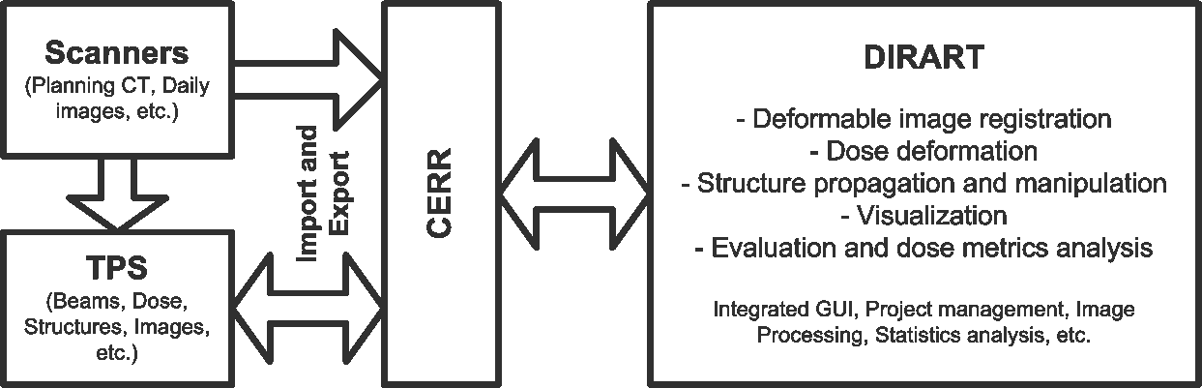
System Flow Chart

Slide 5
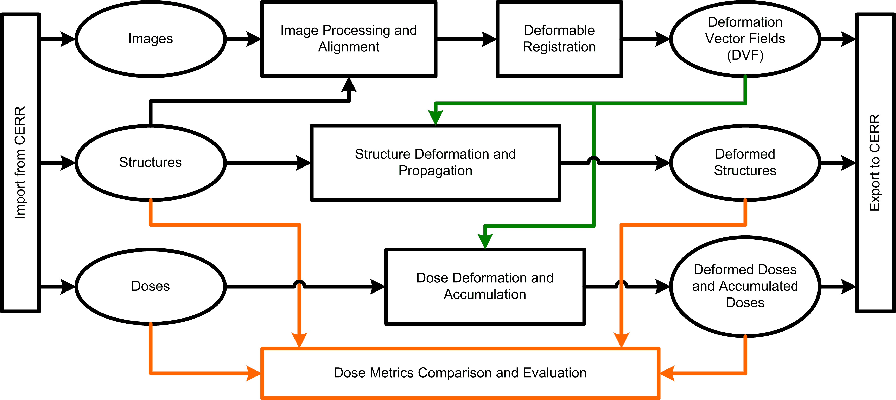
RT Objects and Interactions

Slide 6
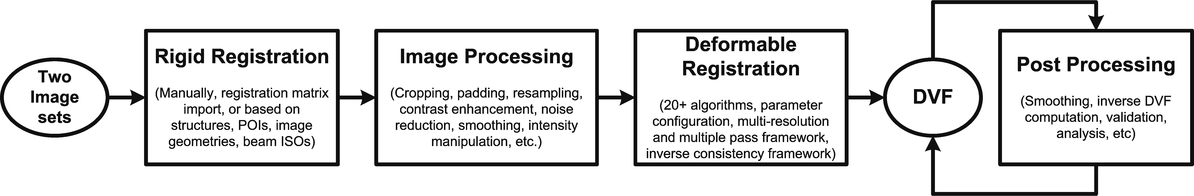
Image Processing and Registration Work Flow

Slide 7
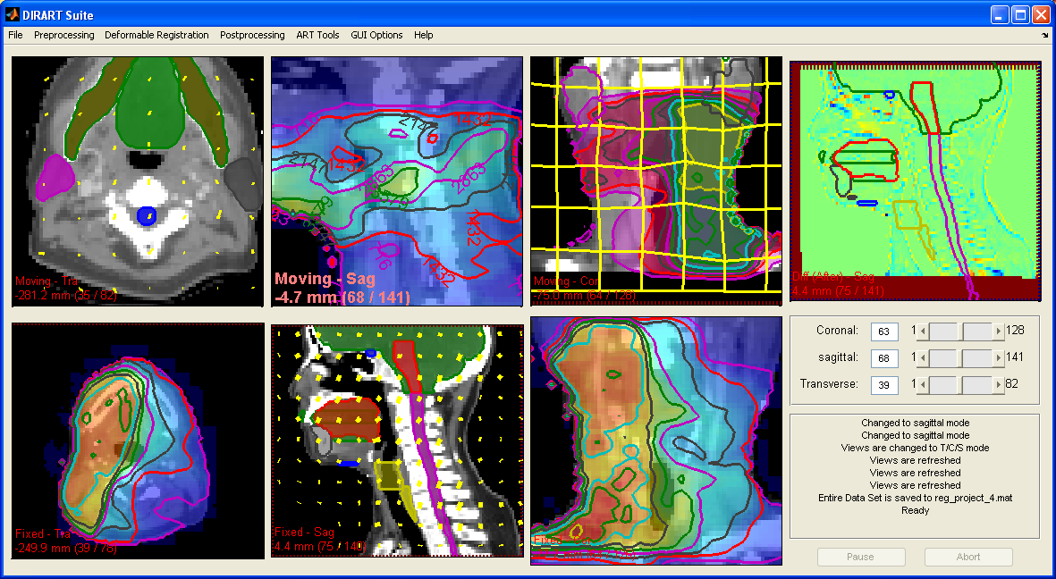
Screen Shot

Slide 8
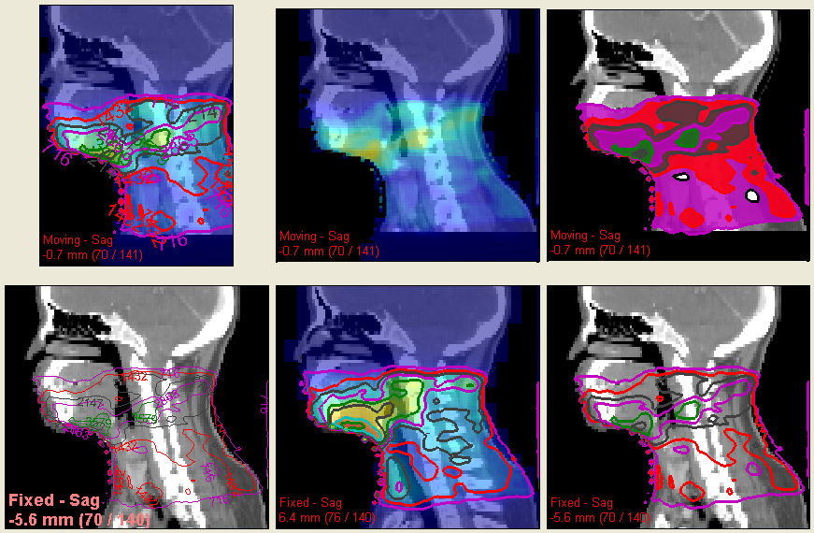
Dose visualization features

Slide 9
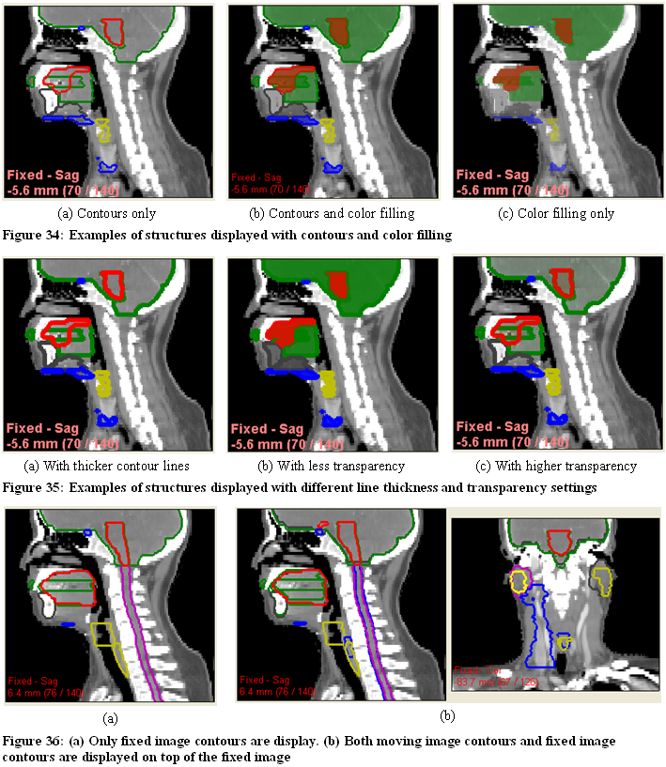
Structure objects visualization features

Slide 10
Example 1: Dose summation for initial plan and re-plan
Export plans as DICOM-RT files from TPS
In CERR
  Load both DICOM-RT plan
  Save as CERR plan (MATLAB) files
In DIRART
  Load the two CT scans from CERR plans
  Aligning, cropping, re-sampling
  Deformable registration and obtain DVF
  Load doses from the CERR plans
  Deform the initial plan dose to the re-plan CT coordinate
  Export the deformed initial dose to CERR
In CERR
  Sum the re-plan dose and the deformed initial dose
  Compute DVH on the sum dose
  Export the sum dose to DICOM-RT, to be loaded back to TPS

Slide 11
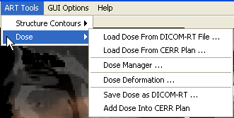
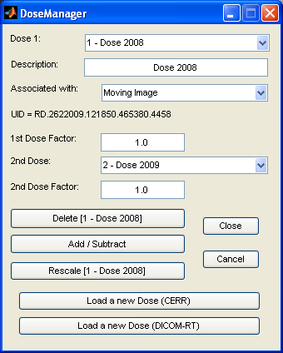
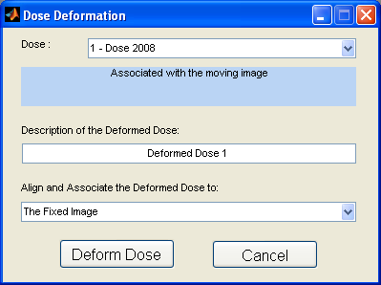
Screen shot of dose functions

Slide 12
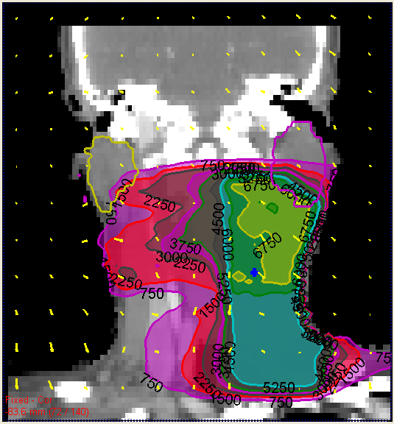
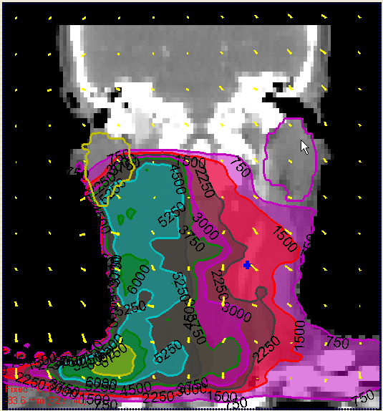
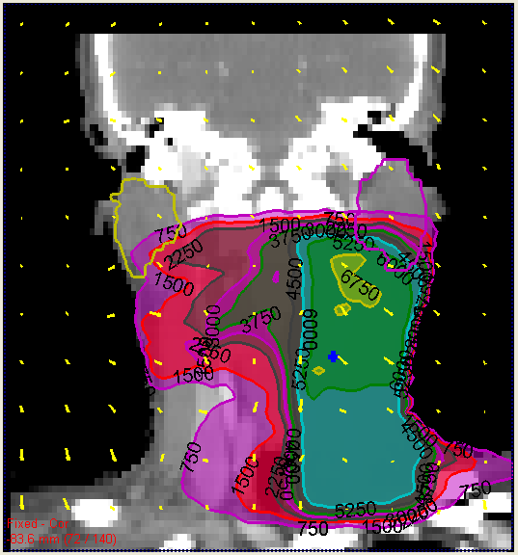
Dose Deformation Examples
Initial Dose | Re-plan Dose | Deformed Initial Dose

Slide 13
Example 2: Structure Contour Deformable Propagation
Export plans as DICOM-RT files from TPS
In CERR, load both DICOM-RT plans, save as CERR plan (MATLAB) files
In DIRART
  Load the two CT scans from CERR plans
  Aligning, cropping, re-sampling
  Deformable registration and obtain DVF
  Load structures from the CERR plans
  Deform the structures from one plan to the other plan
  Export the deformed structures to CERR
In CERR, export the deformed structures to DICOM-RT, to be loaded back to TPS

Slide 14
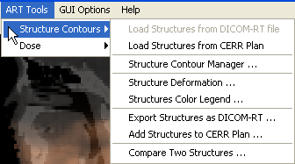
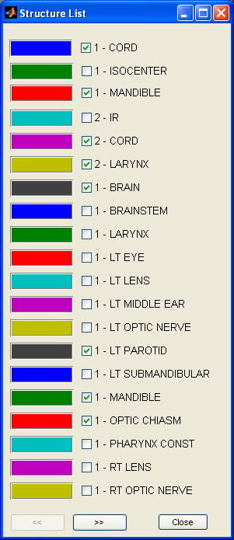
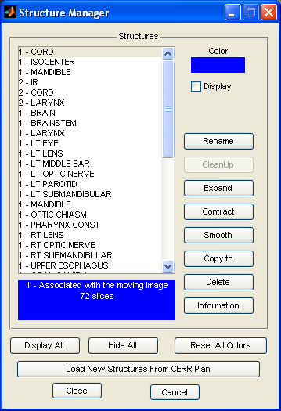
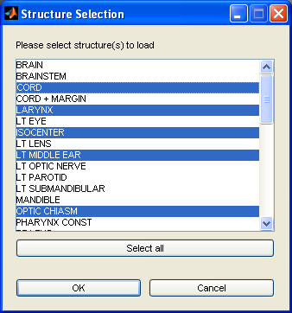
Screen shots of the structure functions

Slide 15
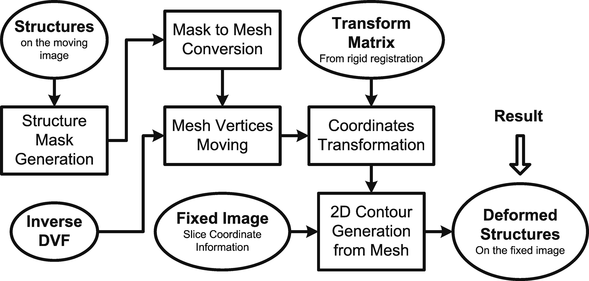
Structure Deformation Work Flow 1

Slide 16
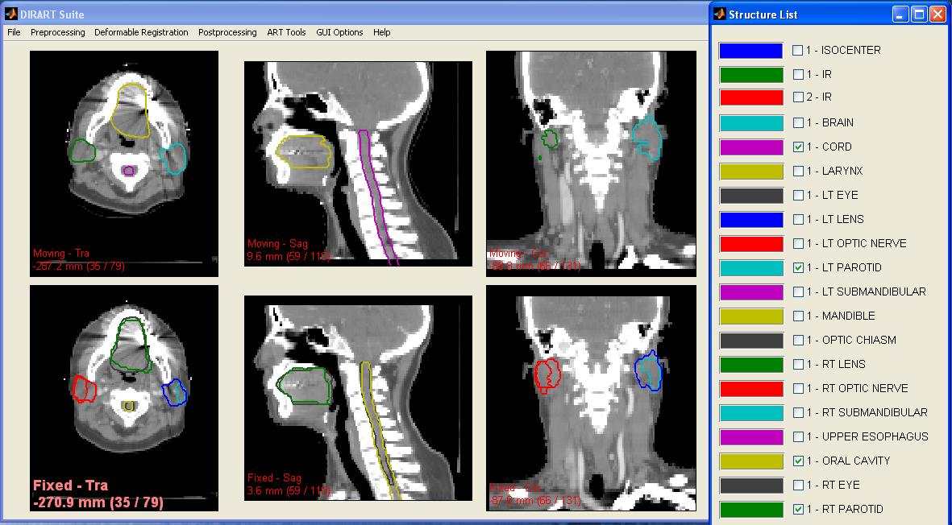
Examples of Structure Deformation

Slide 17
Deformable Image Registration in DIRART
Two frameworks
  The asymmetric DIR framework
  The inverse consistency DIR framework
20+ algorithms, including optical flow algorithms, demons algorithms, algorithms from ITK, etc
Multi-resolution and multiple-pass approaches
Special features: structure-assistance, for partially overlapping images, image intensity manipulation, etc
Use configurable settings

Slide 18
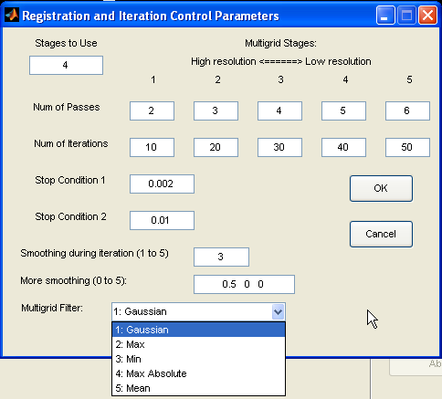

Slide 19
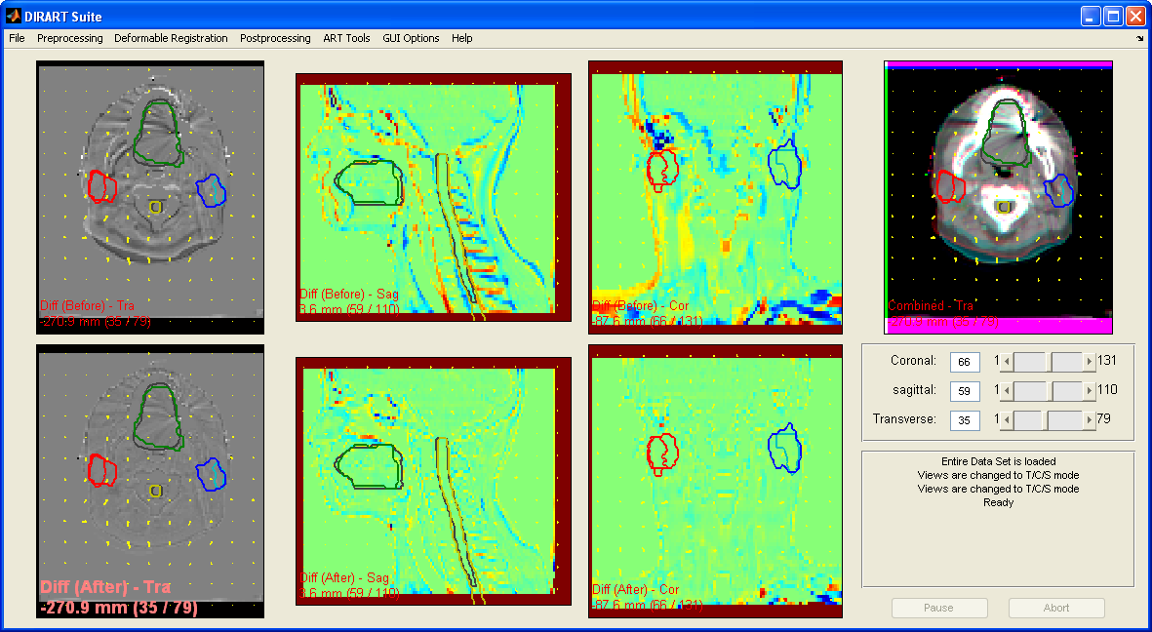
DIR Example

Slide 20
Image Processing in DIRART
Smoothing (Gaussian, edge-perservation)
Contrast enhancement (histogram based, window level transformation, intensity remapping, intensity manipulation, etc)
Cropping and padding
Re-sampling

Slide 21
Performance of DIR
Features in DIRART to improve performance
  Cropping, re-sampling, multi-resolution, image processing, etc.
Computation speed
  1 to 10 minutes
Future
  GPU acceleration

Slide 22
Post-Processing on DVF
Smoothing
Computing the inverse DVF
Converting to the transformation vector fields

Slide 23
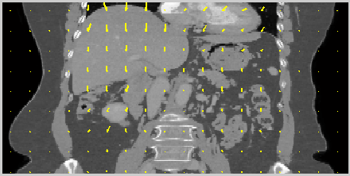
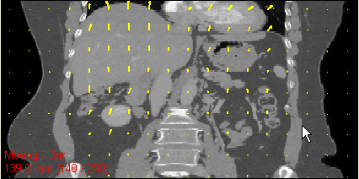
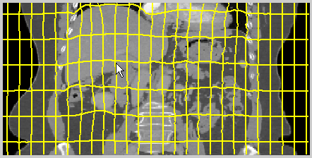
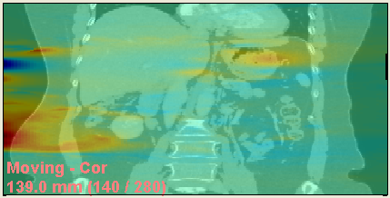
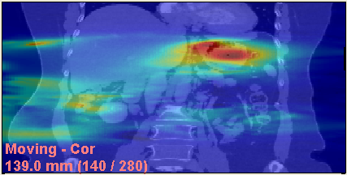
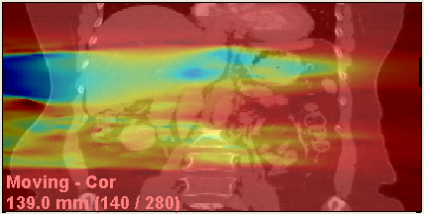
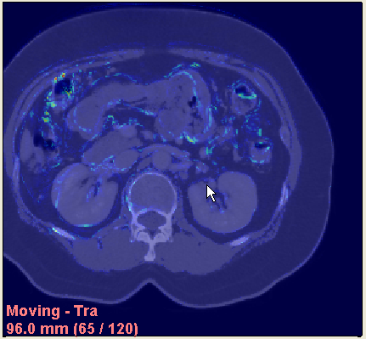
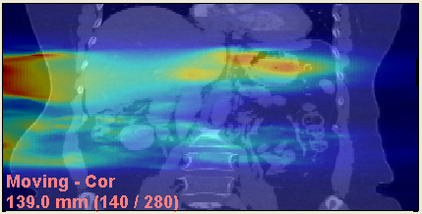
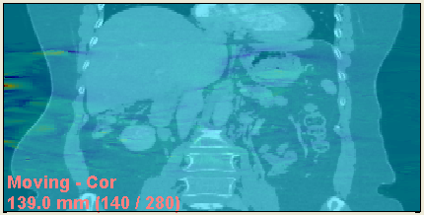
Visualization of DVF
DVF backward | DVF forward | DVF deformation grid
DVF in L-R | DVF in A-P | DVF in S-I
DVF magnitude | Jacobian of DVF | Inverse consistency errors

Slide 24
Validation of deformable image registration in DIRART
Landmark based validation
Ground truth based validation (phantoms, or digitally synthesized phantoms)
DVF analysis
  Jacobian, divergence, Inverse consistency analysis
Image intensity based analysis
  MSE, MI, CC, CR (correlation-ratio)
Structure based analysis
  Structure volume overlay (Dice similarity measurement)
  Structure point geometry error analysis

Slide 25
File and Project Management
Save and load projects
Save and load DVFs
  For the same image datasets

Slide 26
Data inside DIRART
gui_handles: [1x1 struct] info: [1x1 struct] gui_options: [1x1 struct] reg: [1x1 struct] ART: [1x1 struct] images: [1x2 struct] | y: [73x74x51 single] x: [73x74x51 single] z: [73x74x51 single] info: [1x1 struct] ➔ voxelsize: [2 2 3] origin: [72.9492 -74.1211 -25] voxel_spacing_dir: [-1 1 1] type: 'DVF' class: 'single' UID: 'DVF.2322009.101924.439379.481' Fixed_Image_UID: 'CT.1412009.165134.797173.3886' Moving_Image_UID: 'CT.1412009.165440.405190.9237' GenerateBy: 'Reg3dGUI'
image: [134x160x86 single] voxelsize: [2 2 3] origin: [67.8281 -160.5469 -317.9999] voxel_spacing_dir: [-1 1 1] original_voxelsize: [1.1719 1.1719 3.0000] image_deformed: [134x160x86 single] filename: [1x63 char] type: 'unknown' class: 'int16' UID: 'CT.1412009.165440.405190.9237' DICOM_Info: [1x1 struct] original_CERR_Scan_Struct: [1x1 struct] LoadFrom: 'CERR' | structures: {1x16 cell} structure_colors: [16x3 double] structure_display: [1 1 1 1 1 1 1 1 1 1 1 1 1 1 1 1] structure_names: {1x16 cell} structure_assocScanIDs: [1 2 4 4 4 4 4 4 4 4 4 5 5 4 5 5] structure_scanInfos: {1x5 cell} structure_structInfos: {1x16 cell} structure_assocImgIdxes: [2 1 1 1 1 1 1 1 1 1 1 1 1 2 1 2]

Slide 27
Summary
DIRART works together with CERR on DICOM-RT
DIRART works on images, doses and structures
Performs deformation and (off-line) plan adaptation
For DIR and ART research works

